Slide 1


Anti Harassment Training

Slide 2

Anti-Harassment
What is it?
Notes:
Title VII of the 1964 Civil Rights Act:

Slide 3
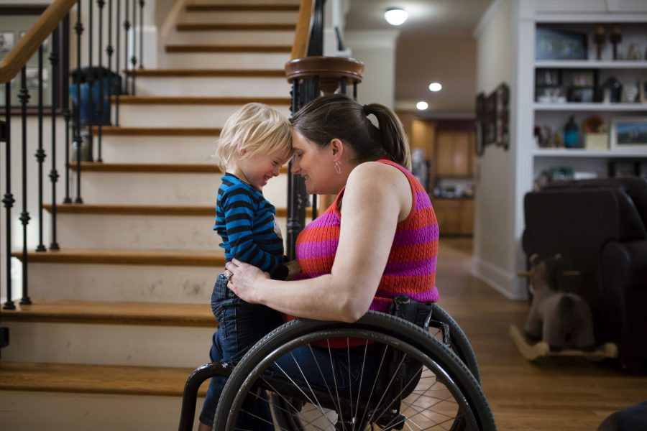
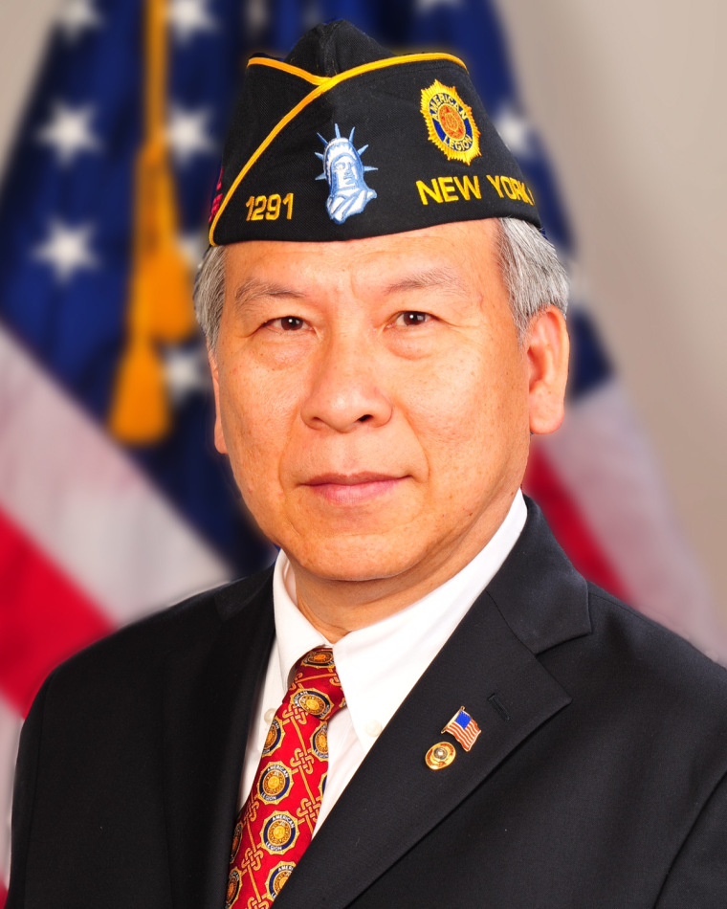
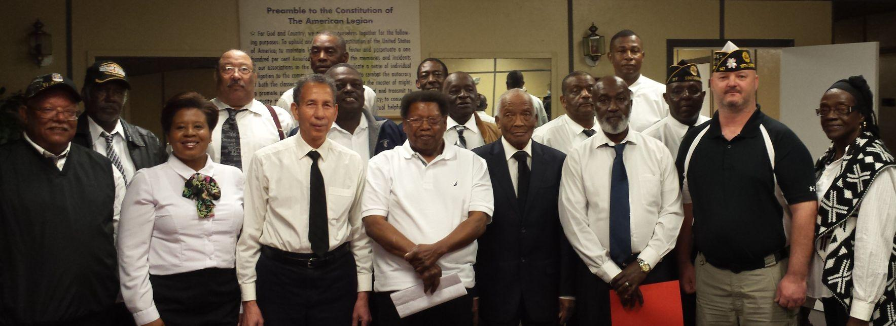


Anti-Harassment
Title VII of the Civil Rights Act of 1964
Prevents Discrimination Based on:
Race
Color
National origin
Religion
Sex
Association with a member of a protected class
Prohibits Retaliation
Notes:
Title VII of the 1964 Civil Rights Act: Original legislation applied to employees of federal and state government

Slide 4
Anti-Harassment
CIVIL RIGHTS ACT OF 1991
Prohibits Discrimination
Persons Association with a member of a protected class
All aspects of employment relationship
Hiring
Terms and conditions
Benefits
Promotion
Layoffs
Termination
Prohibits Retaliation
Notes:
Civil Rights Act of 1991 Moves beyond government employees to private employers.
What about age or disability? Why aren’t they included: Discrimination against older workers or disabled workers are covered under a different law:
Age Discrimination in Employment Act (ADEA) and the Americans with Disabilities Act (ADA). In Arizona we also are required to comply with the Arizona Civil Rights Act.

Slide 5
Anti-Harassment
ARIZONA CIVIL RIGHTS ACT
Prohibits Discrimination
Race
Color
Sex
Religion
National Origin
Age
Physical or Mental Disability
Genetic Testing Results
Pregnancy/Maternity
Hostile Work Environment Prohibits Retaliation
Notes:
Civil Rights Act of 1991 Moves beyond government employees to private employers.
What about age or disability? Why aren’t they included: Discrimination against older workers or disabled workers are covered under a different law:
Age Discrimination in Employment Act (ADEA) and the Americans with Disabilities Act (ADA). In Arizona we also are required to comply with the Arizona Civil Rights Act.

Slide 6
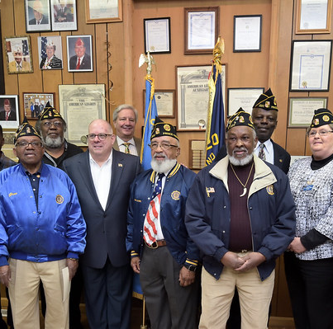
Who Do THESE LAWS APPLY TO?
This Photo by Unknown Author is licensed unde CC BY
Notes:
Fifteen or more employees for twenty weeks or more during the current or preceeding year….Sexual Harassment only have to have one employee.

Slide 7
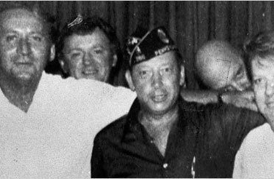
What is Harassment?
Hostile Work Environment
Verbal or Physical Conduct
Unwelcome
Severe or Pervasive
Quid Pro Quo
Notes:
Hostile Work Environment: Subjected to Verbal or physical conduct of a harassing nature. Conduct is unwelcome, severe or pervasive
Objectively and Subjectively Offensive “Reasonable Person Standard” Look at the totality of the circumstances including the frequency of the conduct, the severity of the conduct (rape, assault) whether it is physically threatening or humiliating or merely offensive. Does it interfere with the employee’s work performance.
Quid Pro Quo: This for That. Condition an employment benefit based on employees acceptance of an implicit or explicit condition (sexual favors0. Employer must articulate a legitimate, nondiscriminatory reason for its conduct. If the evidence as a whole demonstrates that the employer’s explanation is pretextual and that it is more likely than not the reason was refusal of sexual advances.

Slide 8

Remedies
Order to Hire or Reinstate
Back Pay
Front Pay
Attorney’s Fees
Compensatory Damages
Punitive Damages
Liquidated Damages for Willful Violations

Slide 9
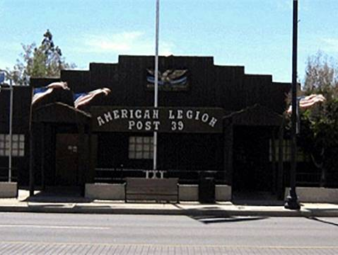
What Are Your Obligations?
Anti-harassment/Bullying Policy
House and Club Rules
Authority of Bartenders/Employees
Responsibility of E-Board
Responsibility of Post Officers
Responsibility of All Members

Slide 10
Anti-harassment and Anti- Bullying are EVERY members’ responsibility

Slide 11
QUESTIONS?

