Slide 1
Be the One
Establishing a Be the One Committee in Your Post

Slide 2
What is Be The One
The American Legion’s primary mission:
Be the One
is a concentrated effort to save the lives of veterans and servicemembers at risk of suicide.

Slide 3
Where do we find more information
http://Betheone.org
Resources and Media
Press Releases
Podcasts
YouTube Videos
Merchandise
Magazine

Slide 4


Slide 5
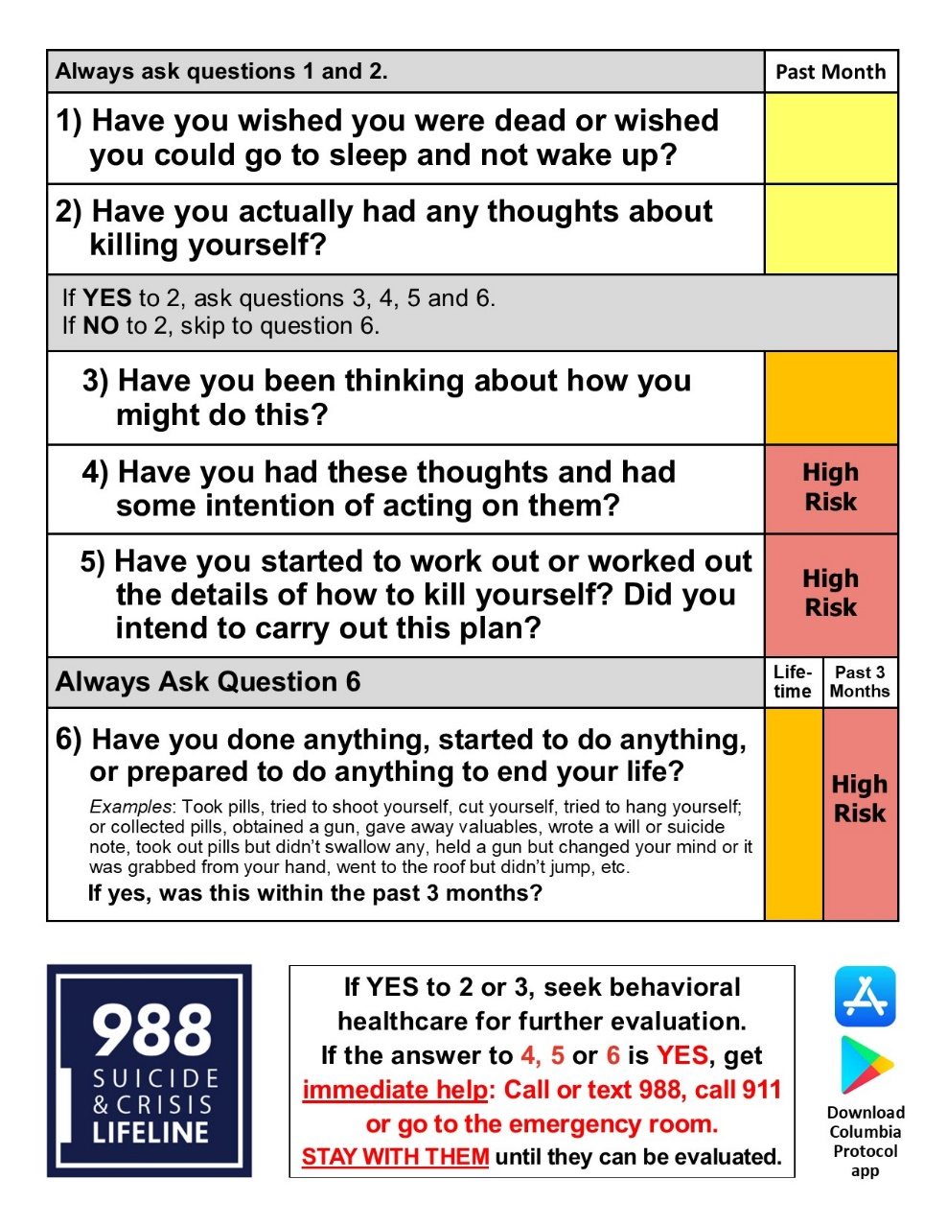
Columbia Protocol Training
https://www.legion.org/advocacy/be-the-one/be-the-one-training

Slide 6
Next Steps
Appoint a Be the One Team
Assign Chair or Co-chair
Notify Brad Heck or Bobbie Kimelton:
brad@azlegioncollege.org or bobbie@azlegioncollege.org
Identify ideas you already do that fit "Be the One"

Slide 7
Sharing Ideas
Challenge Walks to raise awareness and eliminate the stigma
Support groups in partnership with VA/Veteran Community Support Centers for TBI/PTSD/MST
Events – Pro teams, College sports, High school sports
Veterans Day Events – Parades, speeches,
Education/Training - Suicide Prevention
Chaplain Training – Partnership with VA
Service Officer Training
Suicide prevention month activities
Partnership with local hospitals, mental health providers
Partnership with cities and towns – proclamation for Be the One Day
Others ideas??

Slide 8
Identify how to expand on your existing "Be the One" efforts
Identify new ideas for your post to try
Identify money or resources required

Slide 9
IMPLEMENT!

Slide 10

QUESTIONS??

